Slide 1
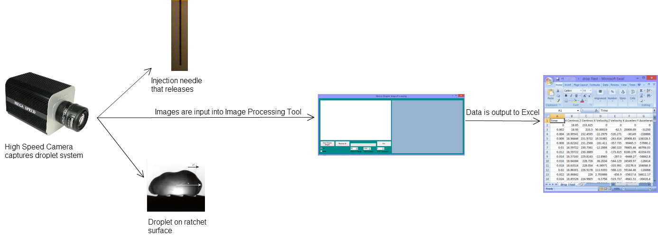
System Architecture

Slide 2
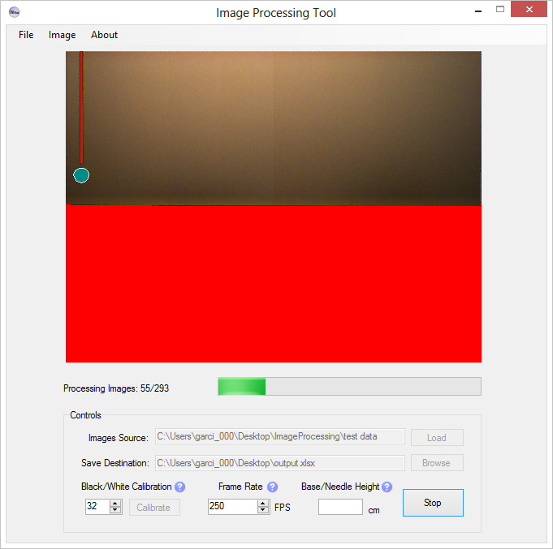
Interface Design

Slide 3
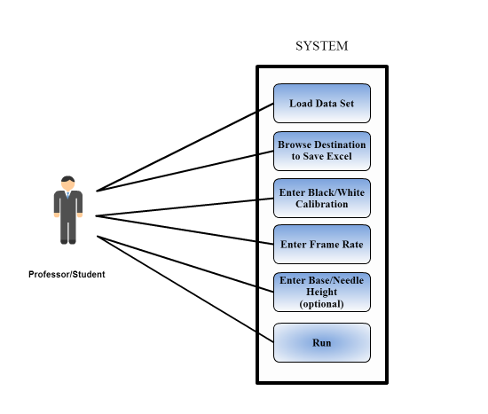
UML Use Case Diagram

Slide 4
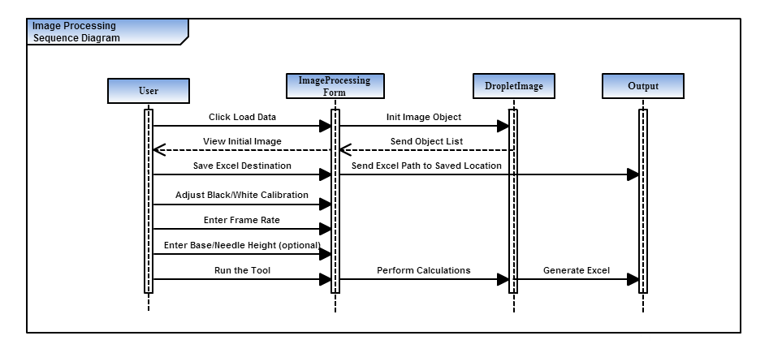
UML Sequence Diagram

Slide 5
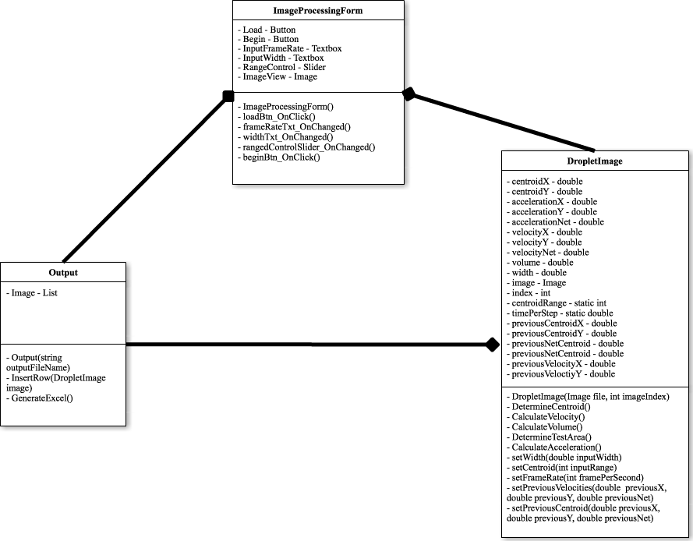
UML Class Diagram

Slide 6
Hypothetical - Romando
What if I had more time?
Perform more test
What if I could start over?
Communicate more with clients
Have necessary resources
What I learned…
Link components together using COM
Importance of documentation/designs
Teamwork

